Slide 1
Tensorflow
2021
Chenqian Xu, Xin He, Steven Zhang

Slide 2
Neural Network Convolutional Neural Network
01

Slide 3
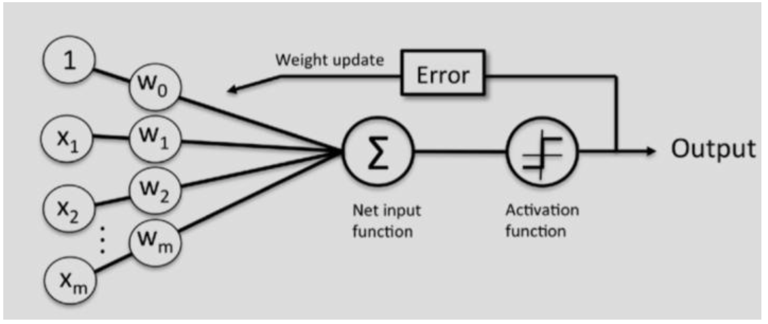
Neural Network
require a lot of data and are very slow!

Slide 4
Convolutional neural network
1
Convolutional layer
2
Activation layer
CNN
3
Pooling layer
4
Fully connected layer

Slide 5
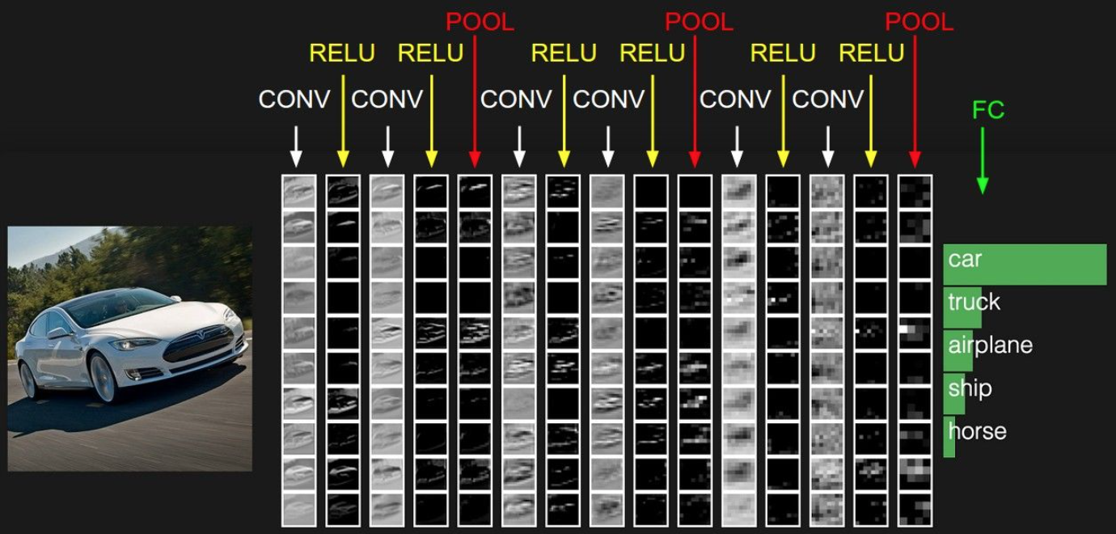
Convolutional Neural Network

Slide 6
Convolutional layer
Convolutional layer performs feature extraction

Slide 7
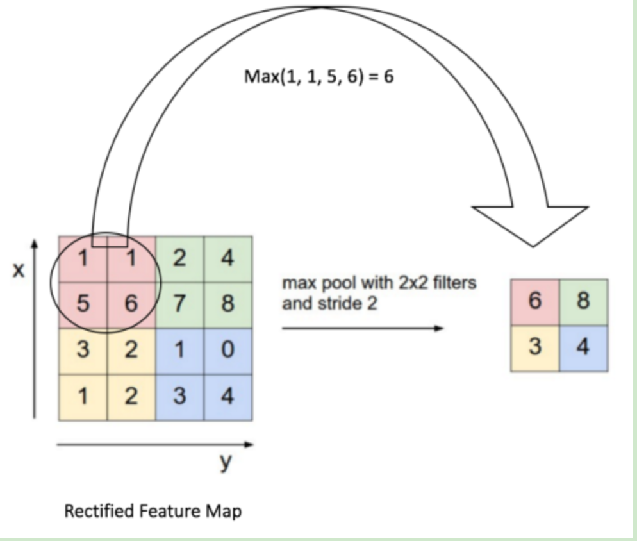
Pooling layer

Slide 8
CNN model in python
02

Slide 9
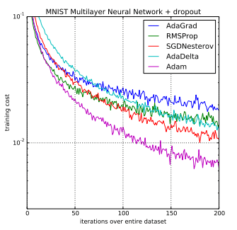
Optimizer

